Slide 1

Face tracking Robotic arm
Robotic Studio 1

Slide 2
Objectives-
Identifying faces using different methods,
Using vision toolbox in MATLAB.
Different methods used for face detection and identification- 4 trials

Slide 3
Viola-Jones algorithm & Kanade–Lucas–Tomasi feature tracker
Identifying faces in an image and a live video
Using- Computer vision toolbox
Function- vision.CascadeObjectDetector

Slide 4
vision.CascadeObjectDetector, using Viola-Jones algorithm
Provide competitive object detection rates in real-time video.
Main features:-
Robust – very high detection rate (true-positive rate) & very low false-positive rate always.
Real time – For practical applications at least 2 frames per second must be processed.
Face detection only (not recognition) - The goal is to distinguish faces from non-faces (detection is the first step in the recognition process).

Slide 5
The algorithm has four stages:
Haar Feature Selection
Creating an Integral Image- Rectangular features
Adaboost Training- Learning algorithm
Cascading Classifiers

Slide 6
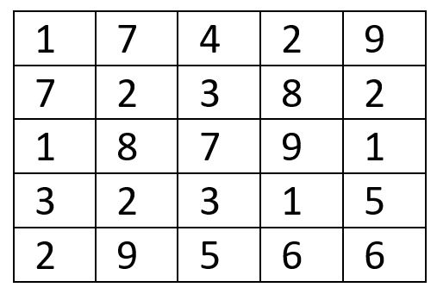
Method used for extracting features

Slide 7
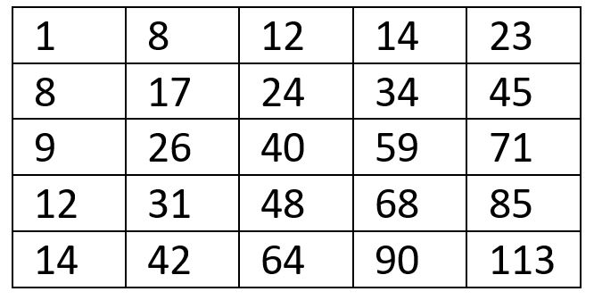

Slide 8
113 – 64 – 71 + 40 = 18

Slide 9

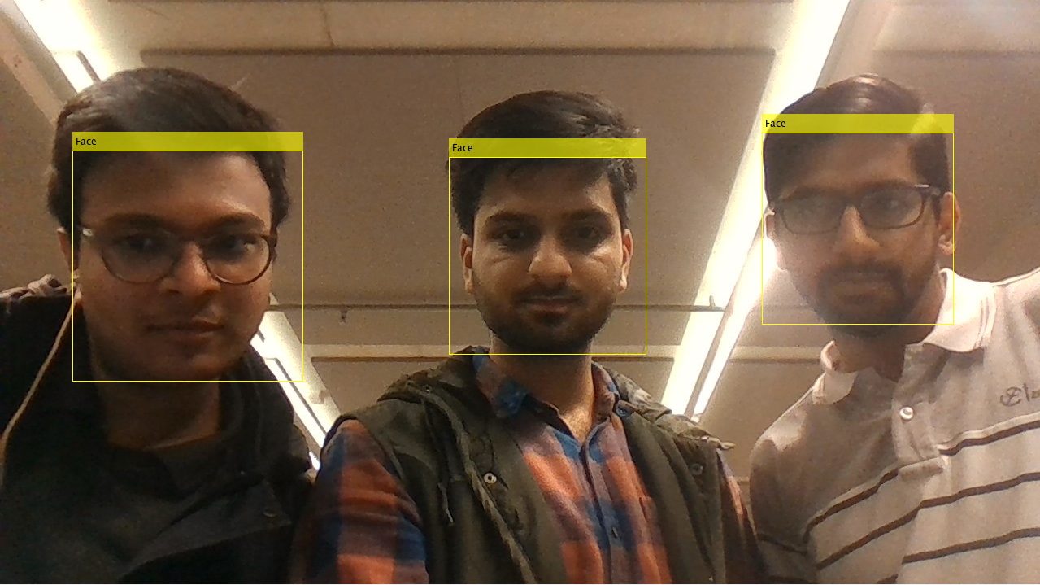
Trial-1
It detects faces in an image.
Multiple faces can be detected.
Chances of error are less because of vast number of classifiers.
It detects “all” the faces.
Not possible to focus on a single face.

Slide 10
Trial-2 Demonstration using a webcam
Detects faces from a live video, taking input from the webcam.
Output is given in form of coordinates on the box and the dimensions of the box.
The size of the box differs with varying distance from the camera.
Focus is on all the faces that comes into he frame.
Can not differentiate faces.

Slide 11
Results obtained
bboxes- 4X4
bboxes(x-axis , y-axis , length of the frame , width of the frame)
Origin- lower left corner of the camera

Slide 12
Trial-3
Identifying particular face, using SURF feature.
Sample image- The input image whose features are extracted.
Full image- The whole image from there the common features are matched and the desired object is identified.
Extracts features from the give image and identifies the face.
Can detect a particular face, but possibility of errors in more.
Picture dependent- If more features detected the technique will fail.

Slide 13
Trial-4
Uses, vision.CascadeObjectDetector
Identifies a face in the frame.
Extract features from the face.
Concentrates in the face.
Tracks the movement of the face.
Does not get confused when another face comes into the frame.

Slide 14
Using MATLAB as a ROS node
MATLAB (Robotics System Toolbox)
rosinit(‘ip_address’)
x= rospublisher('/cmd_vel');
velocity_msg = rosmessage(x);
ROS:-
roscore
roslaunch launch teleop_robot.launch
hostname –I
rostopic echo /cmd_vel

Slide 15
Thank you

